Slide 1
Meats
National Junior Swine Association
Skillathon Resource

Slide 2
Learning Objectives
Identify wholesale cuts of pork
Identify retail cuts of pork
Understand the factors that influence meat quality in pork
Explain where meat products come from on the animal

Slide 3
How Do We Evaluate Meat Quality in Pork?
Meat comes from muscle.
When we evaluate the muscle and leanness, there are three main factors that come into play when determining meat quality:
Color
Color can be referred to as pale (P), red (R), or dark (D). Most consumers prefer to purchase meat that is reddish pink.
Firmness or Wetness
Muscle firmness or wetness can be referred to as soft and exudative (SE) or firm and normal (FN) (or firm and dry (FD)). Firm and Normal or Firm and Dry meats are deemed acceptable for consumers.
Marbling
Marbling is also known as intramuscular fat, meaning the fat within the muscle. This helps give pork its flavor.

Slide 4
What is PSE?
PSE is referred to as Pale, Soft, and Exudative.
This is a condition that describes very low quality pork, and the industry has made many strides to reduce instances of this type of pork.
“Pale” is pork that ranges from light pink to almost light gray.
Consumers will not value meat that looks pale at the retail level.
Pale meat is often accompanied with a firmness and wetness that is described as “Soft and Exudative.”

Slide 5
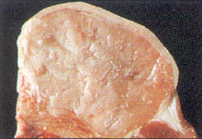
What is PSE?
Soft and exudative means that it does not hold its shape nor does it hold water well.
This meat will often be drier when cooked.
Pigs who test positive OR who are carriers of the stress gene often produce PSE meat.
This is an example of PSE pork. Notice the pale color and the moisture on the surface.

Slide 6
What Is a Wholesale Cut?
A wholesale cut is a larger cut of meat that is often distributed at the wholesale level to grocery stores or meat markets. With pork, we have five main wholesale cuts:
Ham
Belly (Side)
Loin
Boston Butt
Picnic

Slide 7
What Is a Retail Cut?
Within each wholesale cut are a variety of retail cuts are that are more consumer-driven.
These are sized more proportionately for direct consumer purchase.
Many of the meat products you buy are likely retail cuts.
We will go through each wholesale cut and identify the corresponding retail cuts.

Slide 8
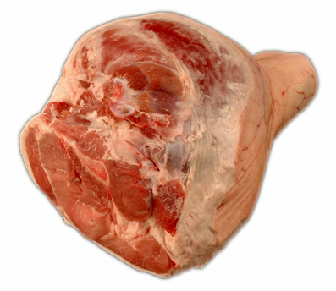
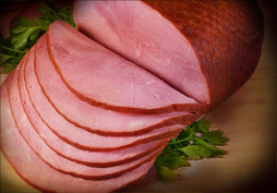
Wholesale Cut #1: Ham
Retail Cuts:
FRESH HAM
BONELESS HAM

Slide 9
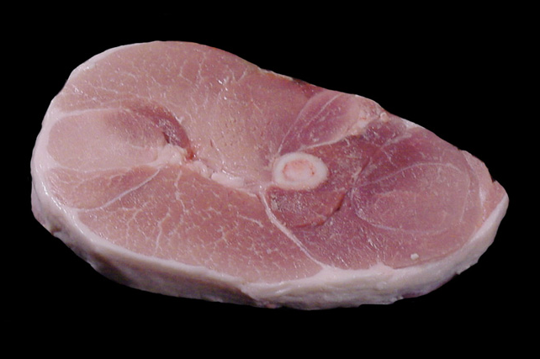
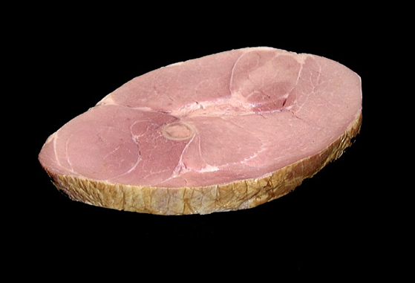
Wholesale Cut #1: Ham
Retail Cuts:
CENTER HAM SLICE
The one on the left is a fresh center ham slice. It is a slice directly from the fresh ham.
The picture on the right shows a cured center ham slice. Curing can take place through soaking or injecting brines. This process is often followed by smoking.
FRESH CENTER HAM SLICE
CURED CENTER HAM SLICE

Slide 10
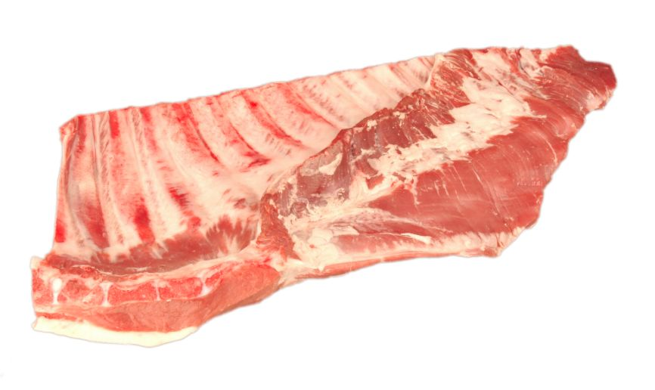
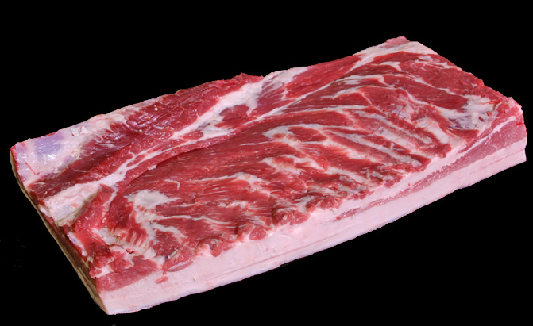
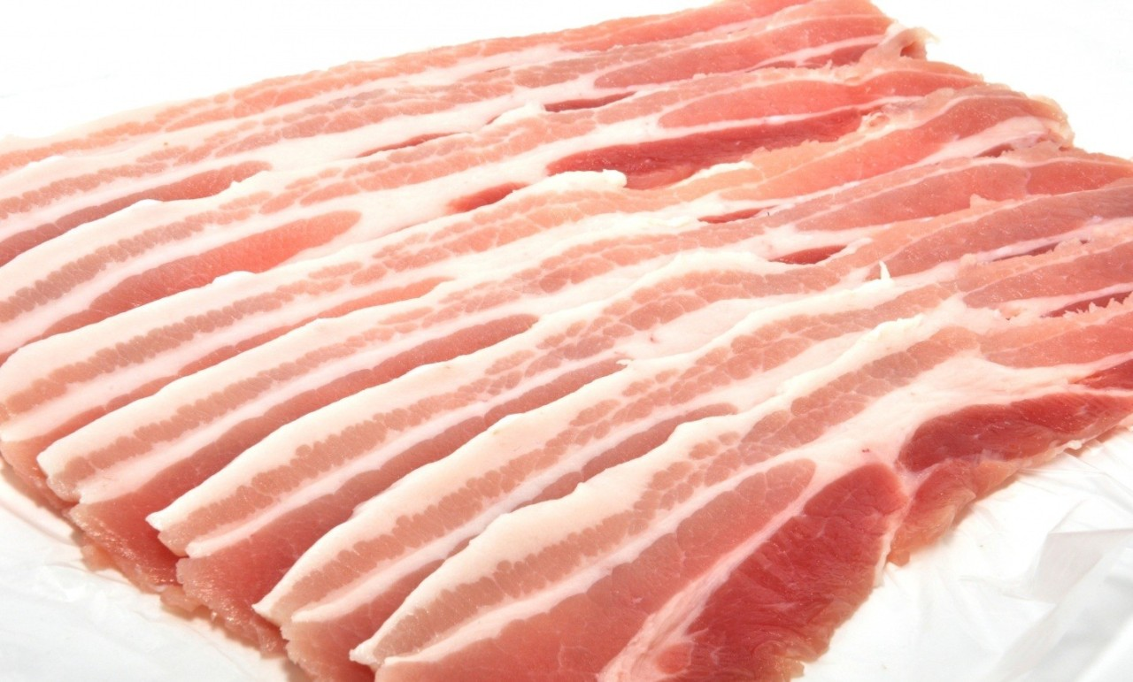
Wholesale Cut #2: Belly/Side
Retail Cuts:
FRESH SIDE
BACON
SPARERIBS

Slide 11
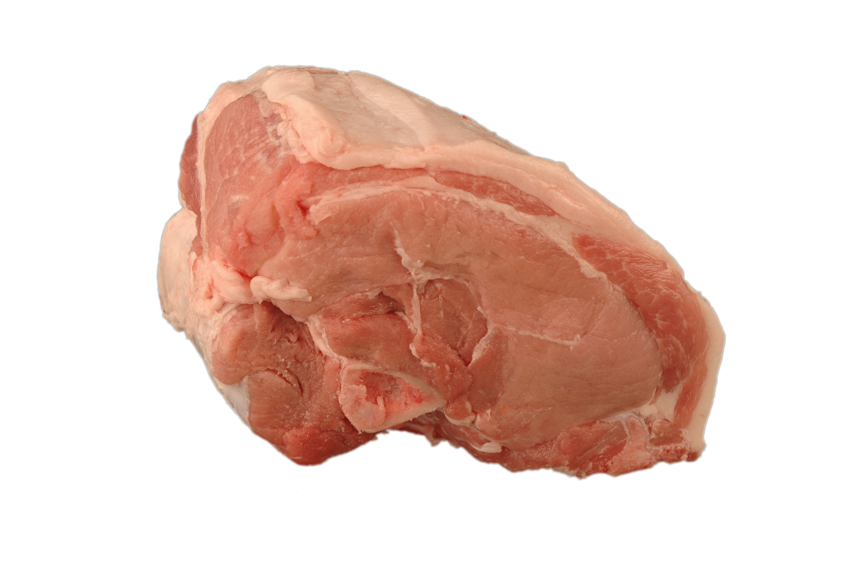
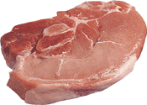
Wholesale Cut #3: Loin
Retail Cuts:
Both of these can also be boneless.
SIRLOIN BONE-IN ROAST
SIRLOIN BONE-IN CHOP

Slide 12
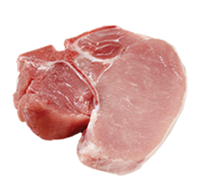
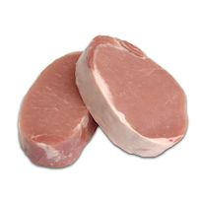
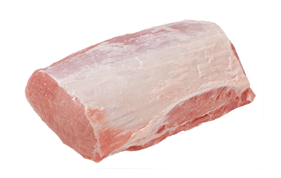
Wholesale Cut #3: Loin
Retail Cuts:
PORTERHOUSE CHOP
BONELESS LOIN ROAST
BONLESS NEW YORK CHOPS

Slide 13
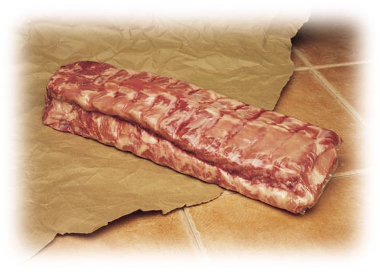
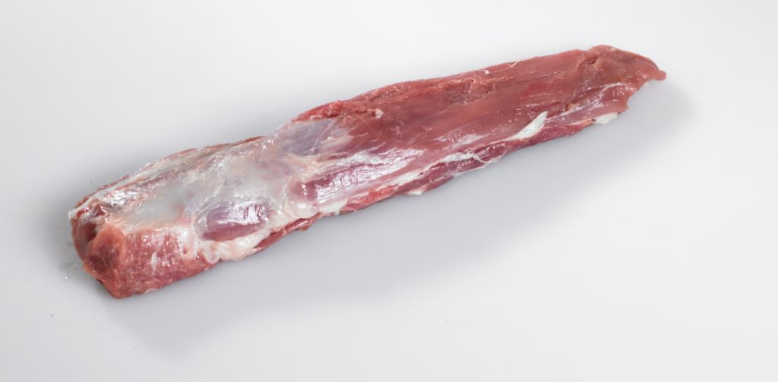
Wholesale Cut #3: Loin
Retail Cuts:
TENDERLOIN
BACK RIBS

Slide 14
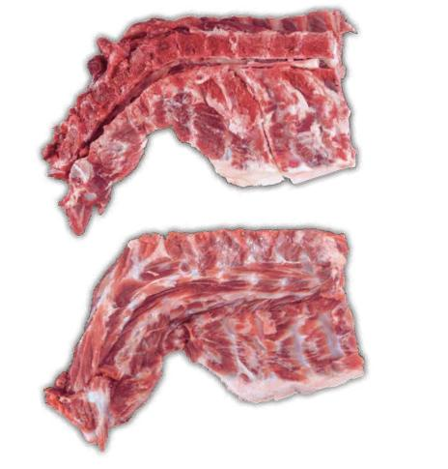
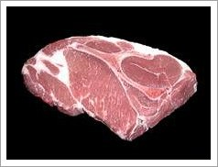
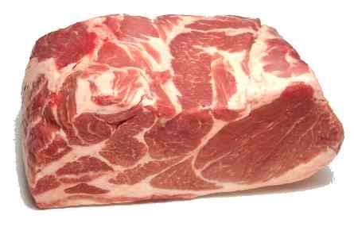
Wholesale Cut #3: Boston Butt
Retail Cuts:
FRESH SHOULDER ROAST
SHOULDER BLADE STEAKS
NECK BONES

Slide 15
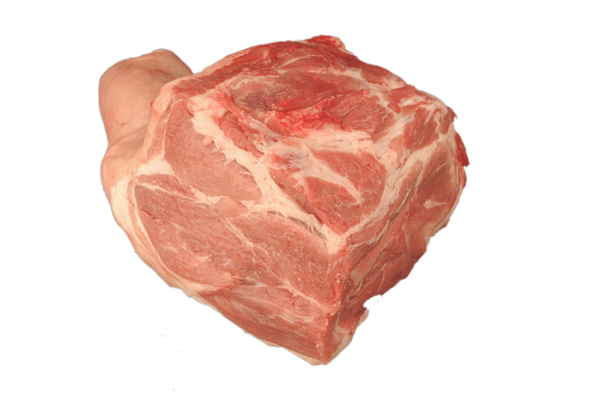
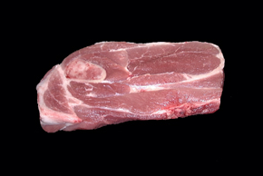
Wholesale Cut #5: Picnic
Retail Cuts:
FRESH PICNIC SHOULDER
ARM PORK STEAK

Slide 16
KNOWLEDGE CHECK!
Let’s see how much of a meat scientist you are now! Take this quiz to test your knowledge! Click “Start Quiz” to begin.
Start Quiz!

Slide 17
1. Which of the following comes from the loin?

Slide 18
CORRECT!
Great Job!
Keep up the great work!
Next Question!

Slide 19
TRY AGAIN!
Be sure to look back in the resource if you need to refresh your memory.
Try Again!

Slide 20
2. PSE stands for Pale, Soft, and Exudative and is considered low quality pork.
TRUE
FALSE

Slide 21
CORRECT!
Great Job!
Keep up the great work!
Next Question!

Slide 22
TRY AGAIN!
Be sure to look back in the resource if you need to refresh your memory.
Try Again!

Slide 23
3. Which meat cut is the tenderloin?

Slide 24
CORRECT!
Great Job!
Keep up the great work!
Next Question!

Slide 25
TRY AGAIN!
Be sure to look back in the resource if you need to refresh your memory.
Try Again!

Slide 26
4. The fresh shoulder roast comes from which wholesale cut of pork?
Picnic
Loin
Ham
Boston Butt

Slide 27
CORRECT!
Great Job!
Keep up the great work!
Next Question!

Slide 28
TRY AGAIN!
Be sure to look back in the resource if you need to refresh your memory.
Try Again!

Slide 29
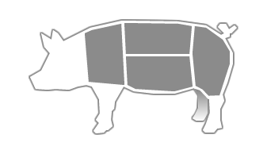
5. Which wholesale cut is being pointed to on this diagram?
Loin
Belly
Ham

Slide 30
CORRECT!
Great Job!
Keep up the great work!
Exit Quiz!

Slide 31
TRY AGAIN!
Be sure to look back in the resource if you need to refresh your memory.
Try Again!

Slide 32
CONGRATULATIONS!
You have completed the “Meats” resource!
Check out our other topics to become a real
swine expert!

